Slide 1

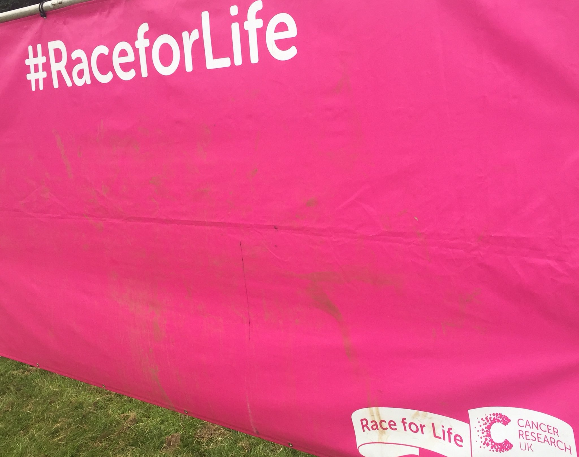
Cancer Research UK
Data collection

Slide 2
Context
Made contact with project manager from CR UK
  We pitched the idea of collecting SNAPPS data at their next events
Given the permission to attend a couple of ‘Race for life’ events.
In return they asked for us to provide 'mini public engagement event' on healthy approaches to training for running to avoid injuries.

Slide 3
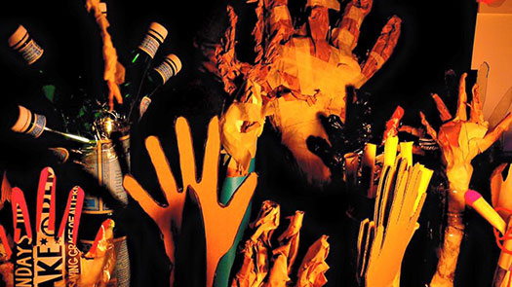
Public engagement
Enter Unit-X!
  Art & Design department
Collaboration was initiated and plan of action conceived.
  Funding was the next step.
We applied for £10k from Nuffield health to fund the project
Notes:
We thought of embedding this data collection activity within a public engagement opportunity.
Provide value whilst collecting data

Slide 4


Slide 5
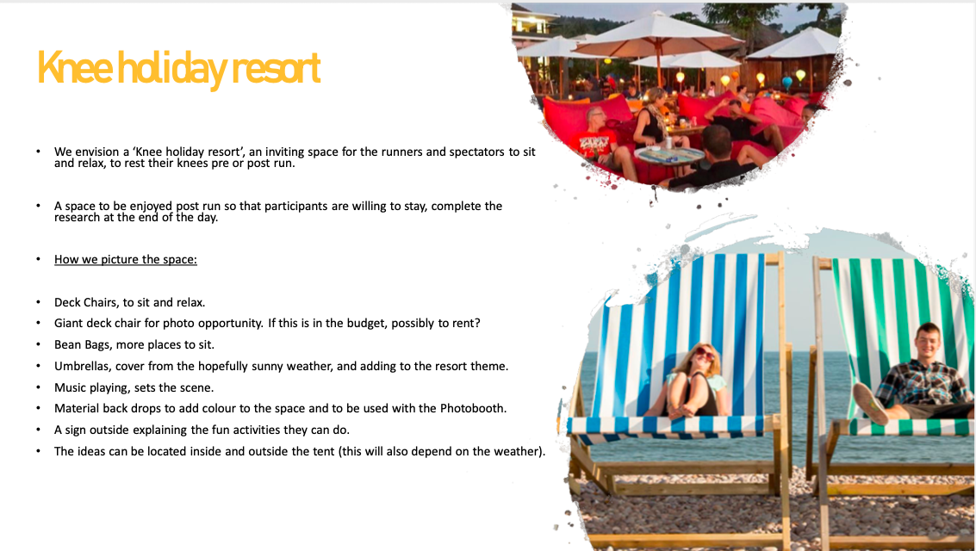

Slide 6
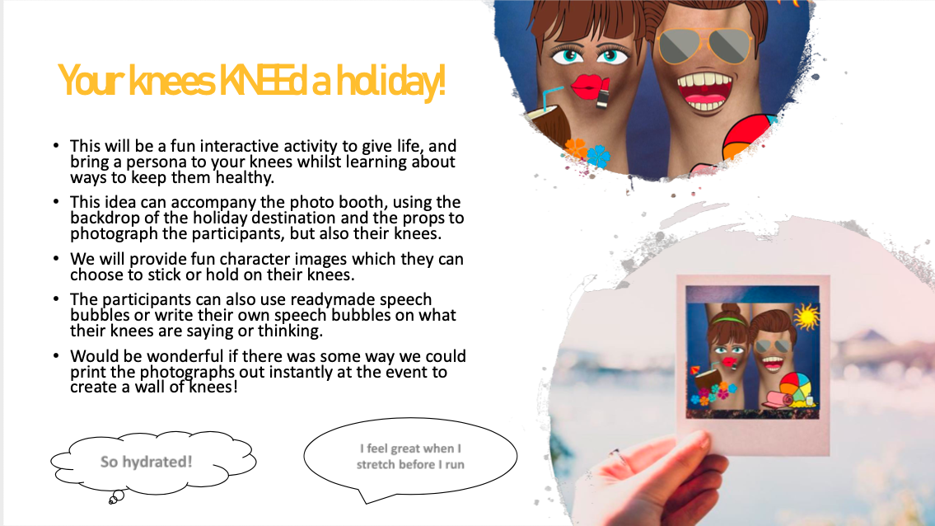

Slide 7
Funding
Proposal for Nuffield Health fund was unsuccessful
Plan B: we won £5k from the Faculty impact award.
Not enough time for Unit-X to do the ‘Knee holiday resort’.
Public engagement and data collection went ahead.

Slide 8
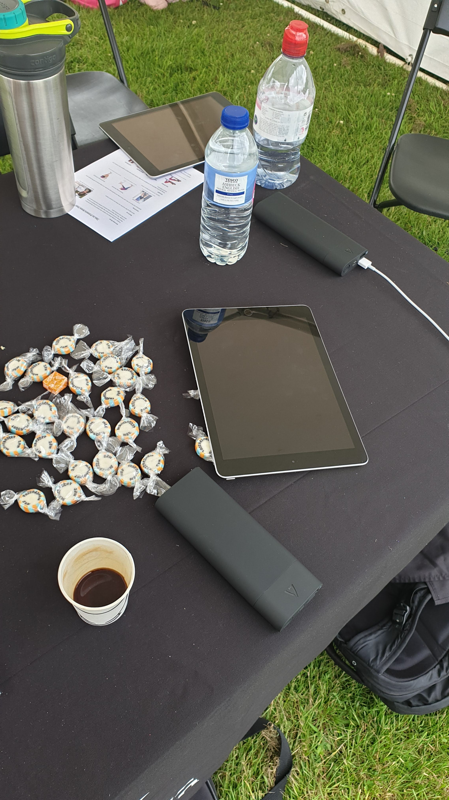
Logistics
Hired a Marquee
Acquired iPads and power banks.
- few more iPads were borrowed from the university.
Employed four students through Jobs4Students
  Two from Physiotherapy
  Two from Nutrition
Made and printed out nutrition and injury prevention flyers

Slide 9
Wigan Event – feasibility study
Wednesday evening
Adults 5km run
Approximately 600 participants
10 data collectors
Each had an iPad (connected with their phone wifi)

Slide 10
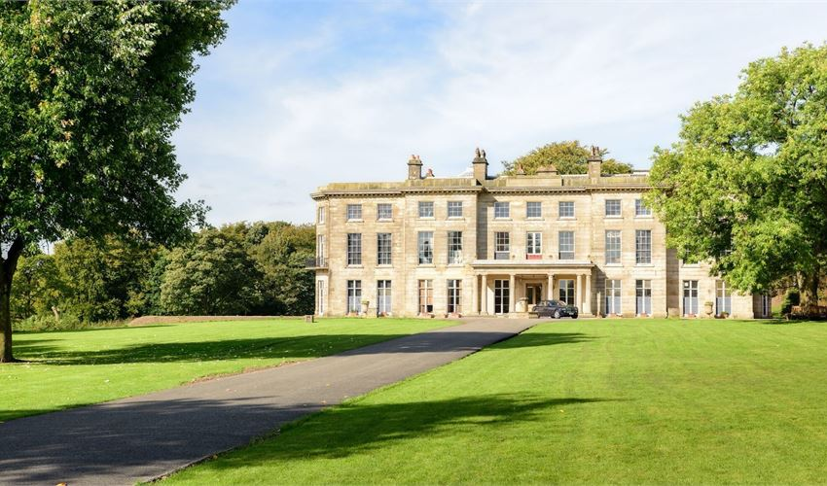
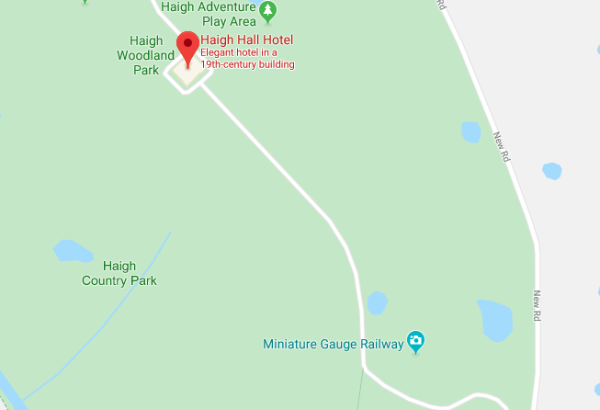
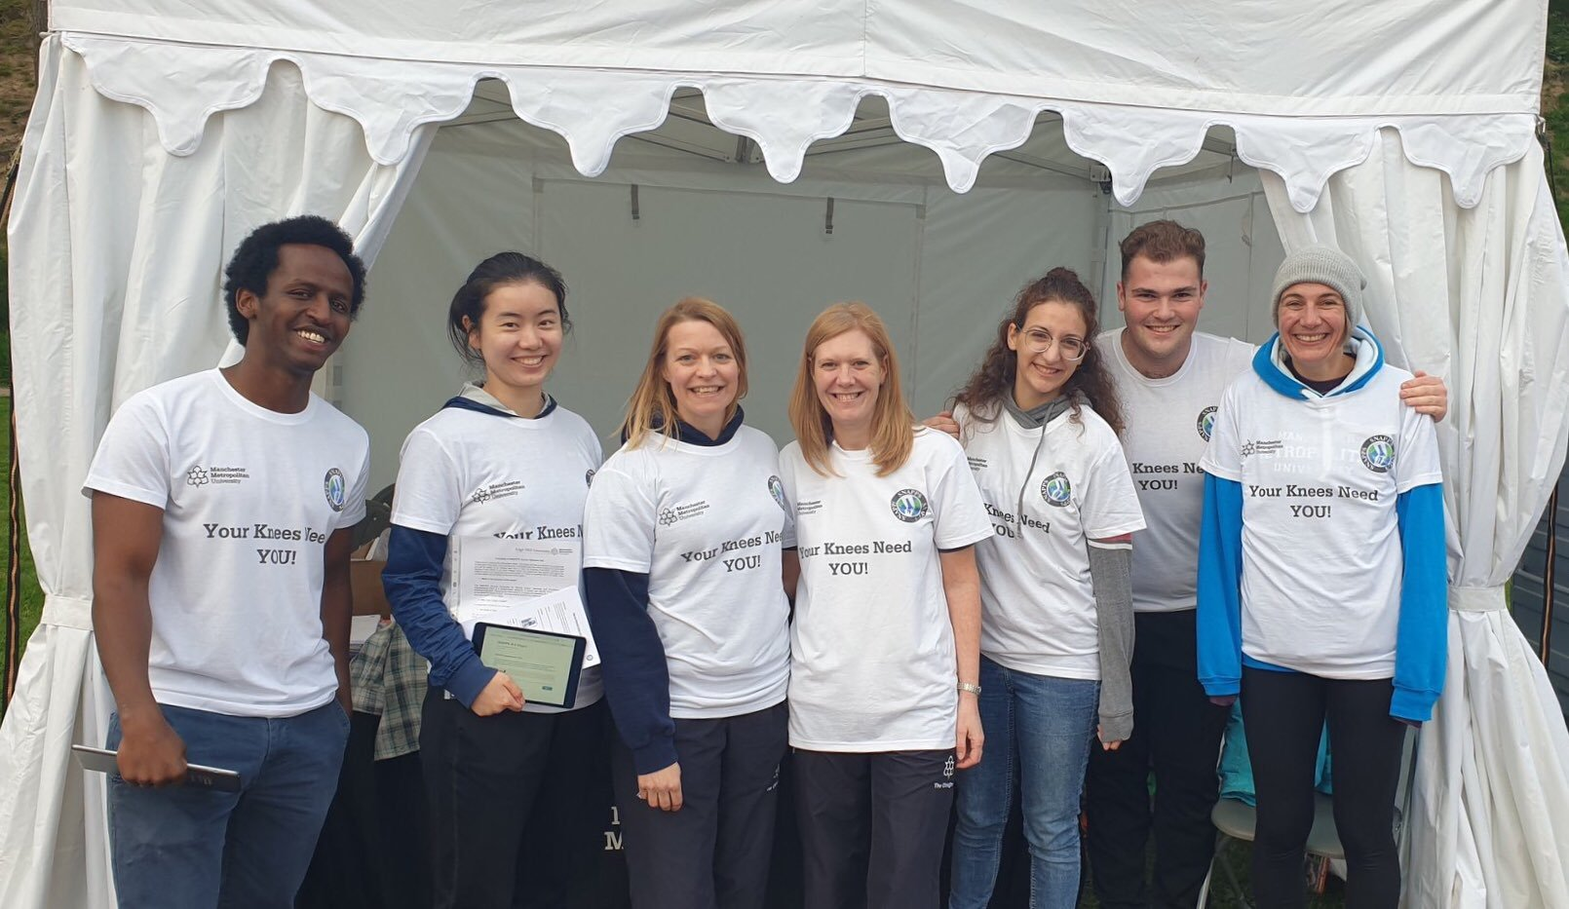
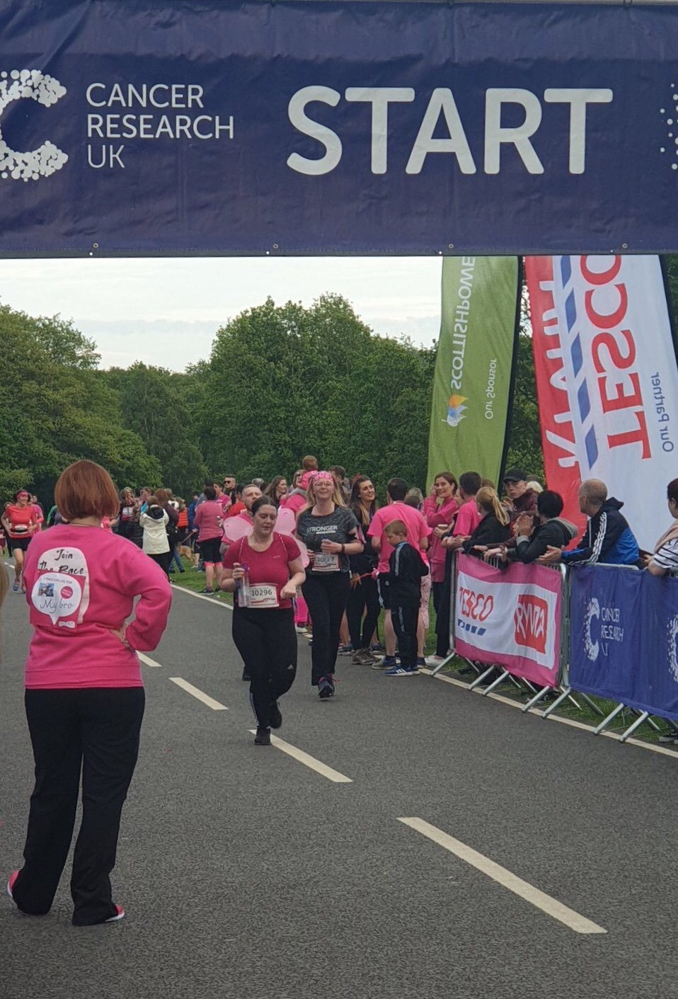
Location
Entrance
Start and finish line

Slide 11
Outcomes
Engaged with attendees regarding knee health and nutrition
Collected 176 responses in under 2 hours
Lots of learning points from the event (subsequent slides)

Slide 12
Highlighted themes
Some attendees were asked to participate in the survey more than once. Felt pestered.
  Solution: Spread out, researchers given designated area to focus on.
Attendees were in clusters. Using one iPad to survey the whole group took some time. Waiting individuals likely to change their mind.
  Solution: To efficiently collect data, work in ‘packs’.

Slide 13
Highlighted themes
Participant were warming up were less likely to be interested in taking part. Same for spectators waiting for friends/family members to cross the line.
  Solution: Not to approach preoccupied individuals, be wary run start and end time
When approaching clusters with older individuals who were keen to participate in the survey, it felt difficult to let them down as they would be over the target age group.
  Solution: when introducing the survey to the attendees, to mention who the survey is for.
Notes:
“…we are currently conducting a survey on knee health for adults between the ages of 18-40…”.

Slide 14
Heaton Park– Main event
Weekend event in July - all day
Adults 5km and 10km run. Family mud runs.
Approximately 7700 adults participating
10 data collectors
Each had an iPad (connected with their phone wifi) + Backup dongle

Slide 15
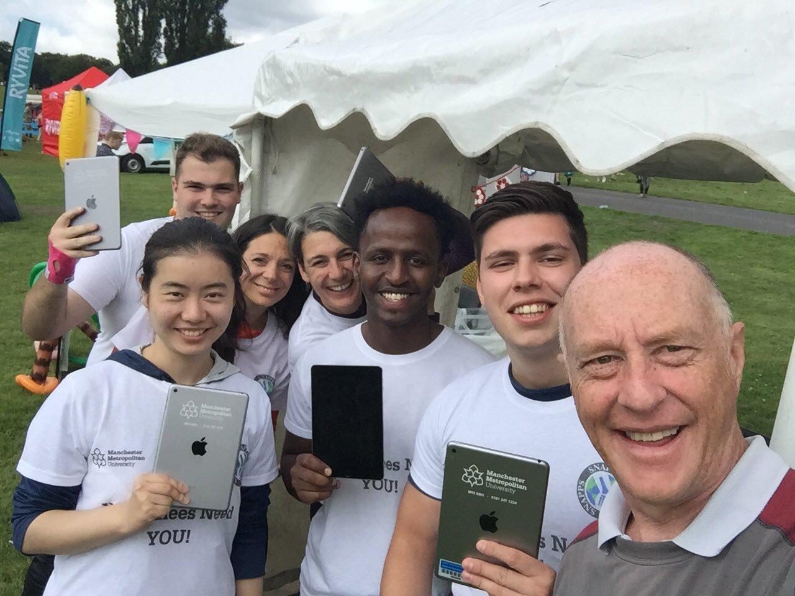
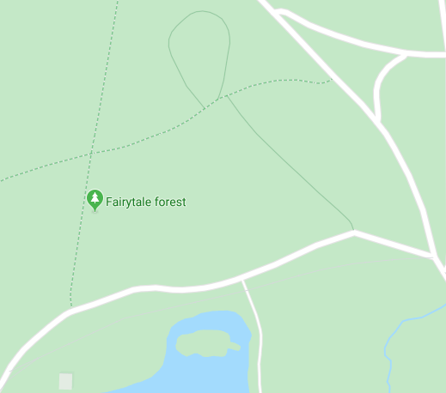
Our location
End
Food and coffee queues
Start line
= Researchers
= Marquees
= Toilets

Slide 16
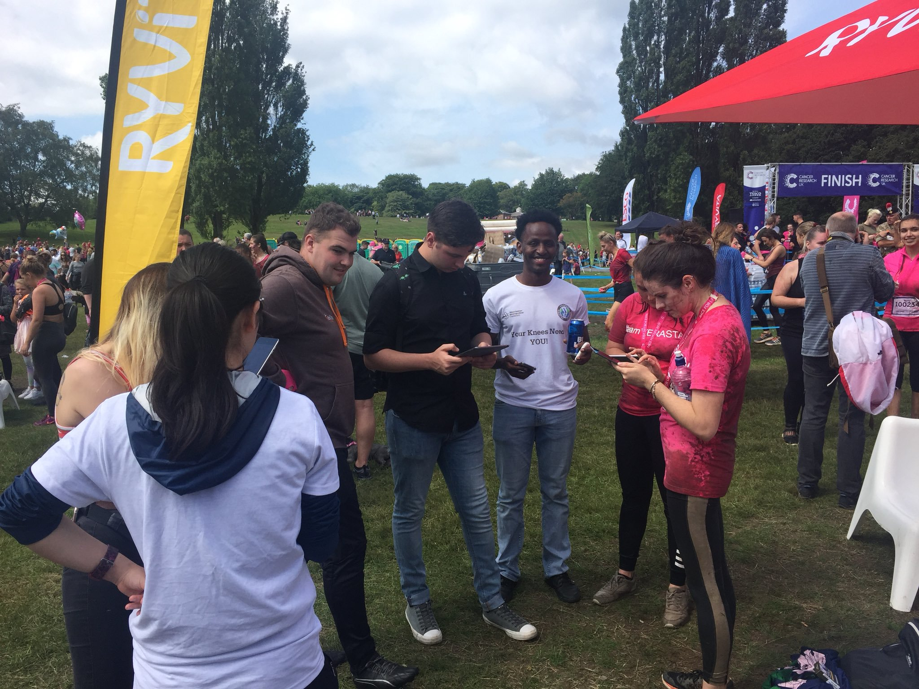
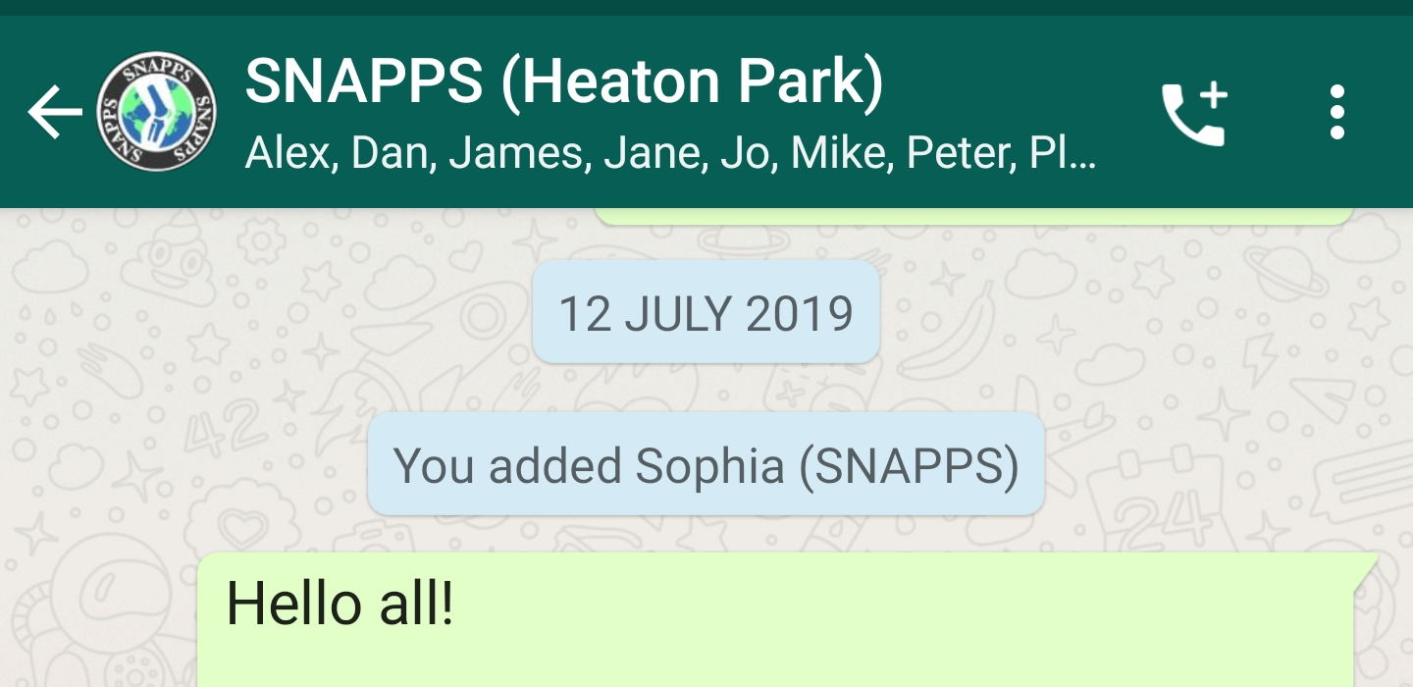
Game plan
‘Hunt in packs’
We spread out, each group with a designated area
  Heaton park much bigger than Haigh Hall
One person at the marquee, rotate ever hour or so.
We used WhatsApp to communicate

Slide 17
Before Kids Mud run
Before adults mud runs
Early arrivers
10:00
13:00

Slide 18
Internet issues
Post run
Before 10km
Before 5km
09:00
10:00
11:00
12:00

Slide 19
Issues and areas of improvement
Internet connection dropped just before and after runs
  Lots of people uploading videos and pictures of friends and family
We had a spare dongles that used separate connectivity
  Only limited number of iPad could connect
  More dongles foe next time.
Questionnaire length could be reduced by cutting out the non-scored section.

Slide 20
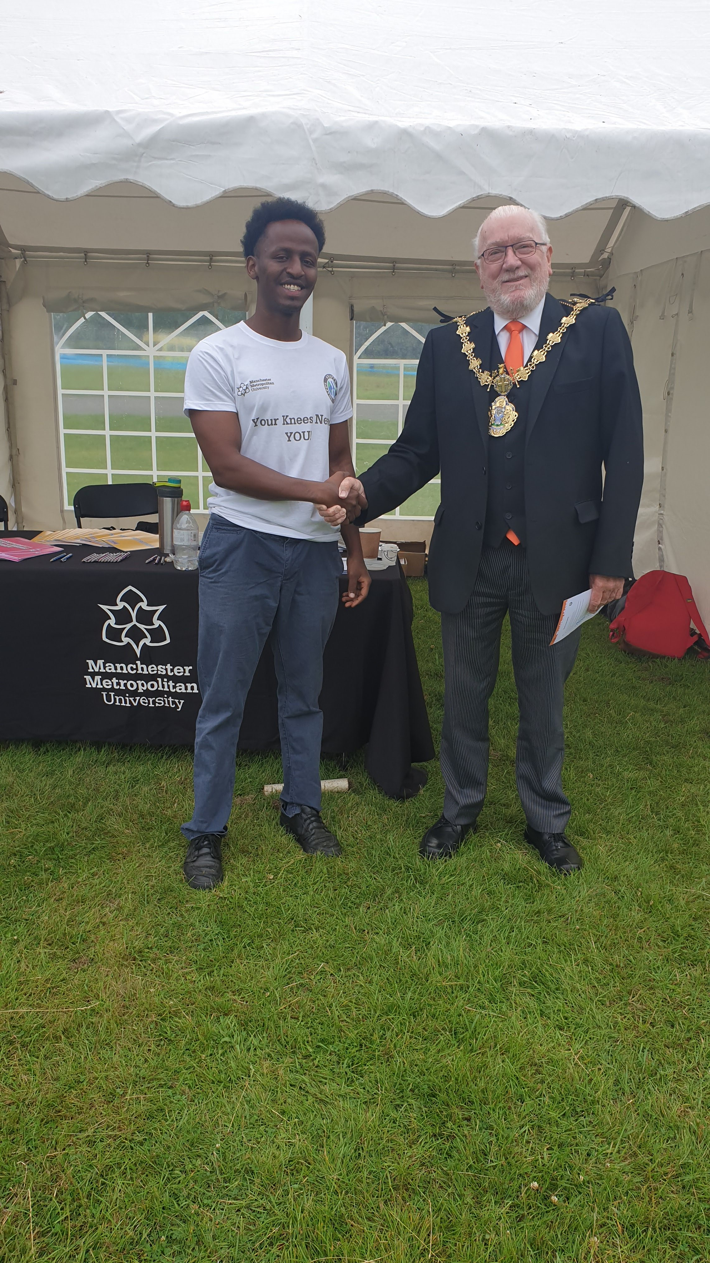
Outcome
1,009 Responses collected
  Saturday 600 participants
  Sunday 409 participants
Successful public engagement
Learning points around population-based field data collection
We even had visit from mayor of Prestwich.

Slide 21
Thank You!

