Slide 1
Translation and cultural validation of self-reported health measures:
An example using the SNAPPS questionnaire.
S tudies of the prevalence
N atural history and
A etiology of
P atellofemoral
P ain
S yndrome
Selfe J, Callaghan M, Yusuf M, Relph N, Gichuru P, Dey P

Slide 2
Background
The questionnaire is designed to identify patellofemoral pain (PFP) in the general population and was created specifically for use in large-scale cohort studies
The sensitivity, specificity and reliability of SNAPPS has been established in the UK (Dey et al. 2016)
Prior to use in other countries SNAPPS requires translation
This study reports on the practical use of guidelines developed by Beaton et. al., (2000) for translating and culturally validating self-administered health questionnaires

Slide 3
Methods 1: Forwards Translation (FT)
In our example translators do not need to be medically trained as the instrument is designed for the general population
2 native target language speakers with fluent English skills independently forward translated SNAPPS (FT1:FT2)
Following this, they compared versions and formed a consensus version (FT3)

Slide 4
Methods 2: Backwards Translation (BT)
FT3 backwards translated into English (BT1:BT2) by 2 different bilingual target language English speakers
BT1:BT2 were reviewed by expert committee most of whom were involved in developing SNAPPS to determine the validity of the translated version
Feedback on discrepancies between BT1:BT2 or deviations in meaning from the original was provided to the lead translator via skype
Lead translator finalised the new language version of SNAPPS

Slide 5
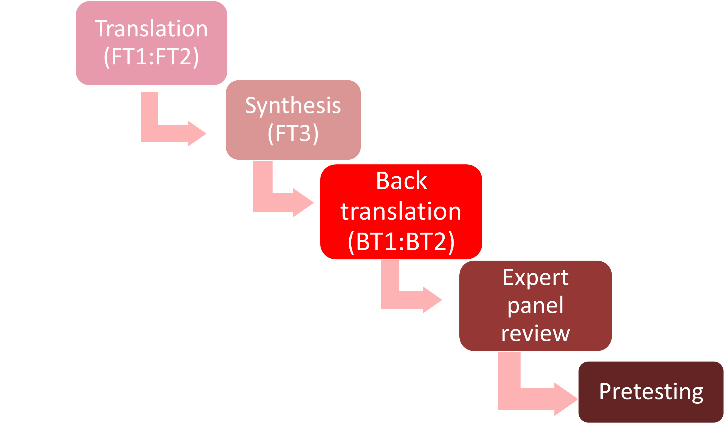
Methods

Slide 6
Results
The accuracy of the translations has been very high with only minor discrepancies between translators and minor deviations from the original
Although minor these do need reviewing

Slide 7
Linguistic Example
The original is phrased “would you suffer” referring to an activity that people may be avoiding because they know it causes pain
This was often backwards translated into English as “do you experience”
This could relate to a response to an activity that has taken place
Although subtle, this difference is significant as the question intends to measure activity avoidance, not activity participation

Slide 8
Linguistic /Cultural Examples
“Walking Down Slopes” was translated into “Walking Downhill” in both Finnish and Dutch!
There were some English expressions where there was no German equivalence

Slide 9
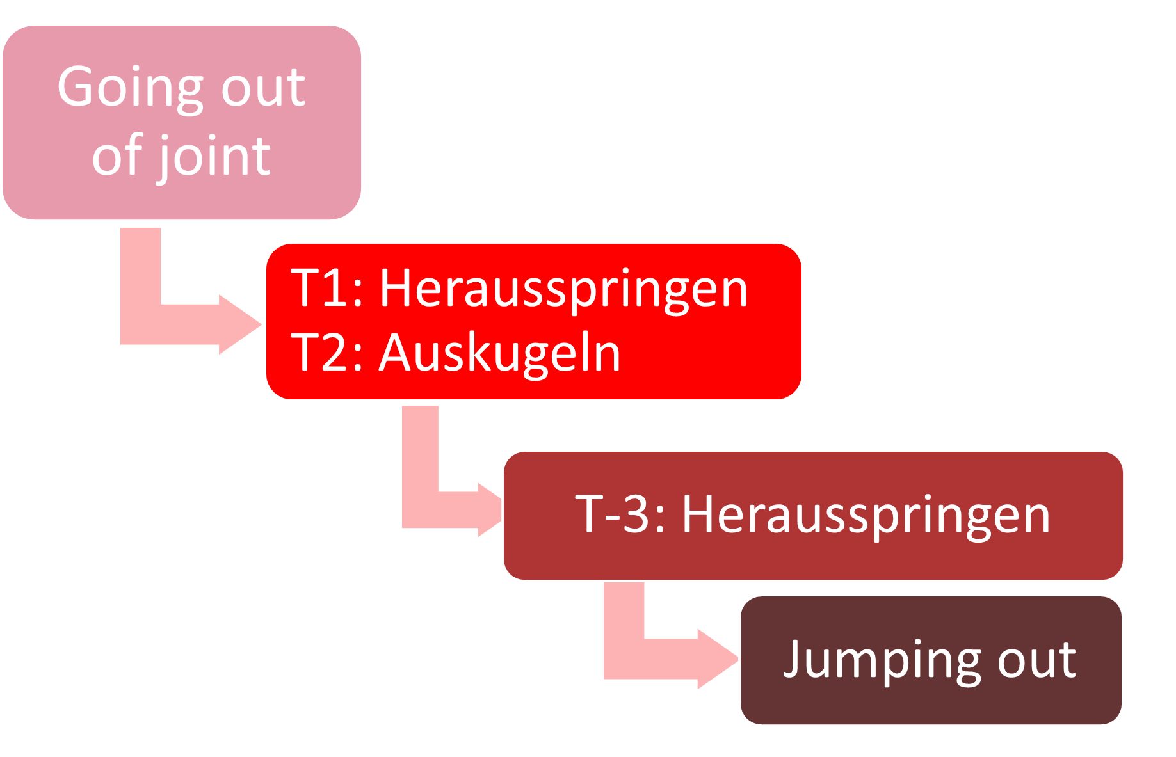
German Examples

Slide 10
Conclusion
We have found that the whole process takes approximately 12 months to complete
This is a considerable investment in time but it leads to a robust result i.e. a questionnaire that can be used with confidence in new linguistic and cultural environments
The minor yet important differences that emerge emphasise that simple translation is not sufficient.
The Beaton et. al., (2000) guidelines provide a clear and comprehensive approach to translation and cultural validation of self-administered health questionnaires

Slide 11
Conclusion
Our completed translations are freely accessible at www.snappspfp.com
The next stage is to use SNAPPS widely in general populations and identify exactly how common is patellofemoral pain (PFP)?

Slide 12
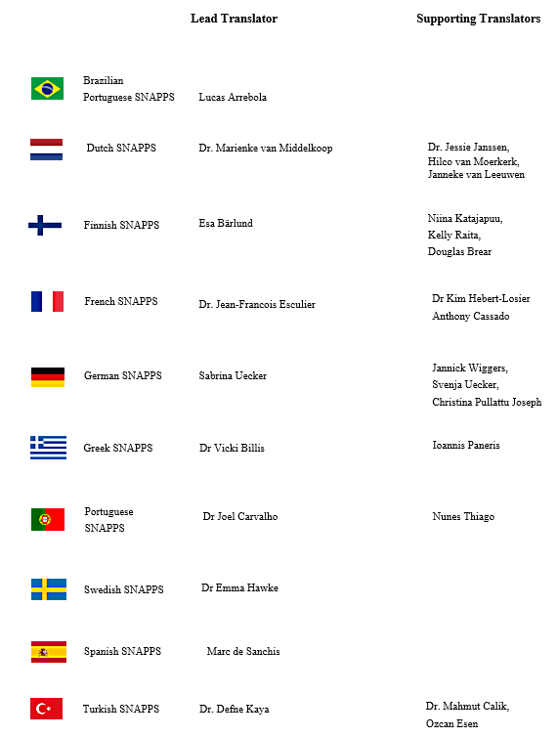
Very many thanks to our international collaborators

Slide 13
References
Beaton, D. E., C. Bombardier, F. Guillemin and M. B. Ferraz (2000). "Guidelines for the process of cross-cultural adaptation of self-report measures." Spine (Phila Pa 1976) 25(24): 3186-3191.
Dey, P., M. Callaghan, N. Cook, R. Sephton, C. Sutton, E. Hough, J. James, R. Saqib and J. Selfe (2016). "A questionnaire to identify patellofemoral pain in the community: an exploration of measurement properties." BMC Musculoskeletal Disorders 17: 237.

