Slide 1

The Prevalence of Patellofemoral Pain in the Community
Jennifer Thorpe, MS, ATC, CSCS*
Paola Dey, MD†
Jennifer Earl-Boehm, PhD, ATC, FNATA*
*University of Wisconsin-Milwaukee, USA
†Edge Hill University, Ormskirk, UK

Slide 2
Problem
Previous research on PFP prevalence has been based on research in closed populations (i.e. athletic, military, hospital/clinic).
Not all PFP patients may elect to seek medical attention for their pain.
The Survey instrument for natural history, Aetiology, and Prevalence of Patellofemoral pain Studies (SNAPPS) was created to identify those in the community with PFP ¹
¹ Dey P, Callaghan M, Cook N, et al. A questionnaire to identify patellofemoral pain in the community: an exploration of measurement properties. BMC Musculoskelet Disord. 2016;17:237.

Slide 3
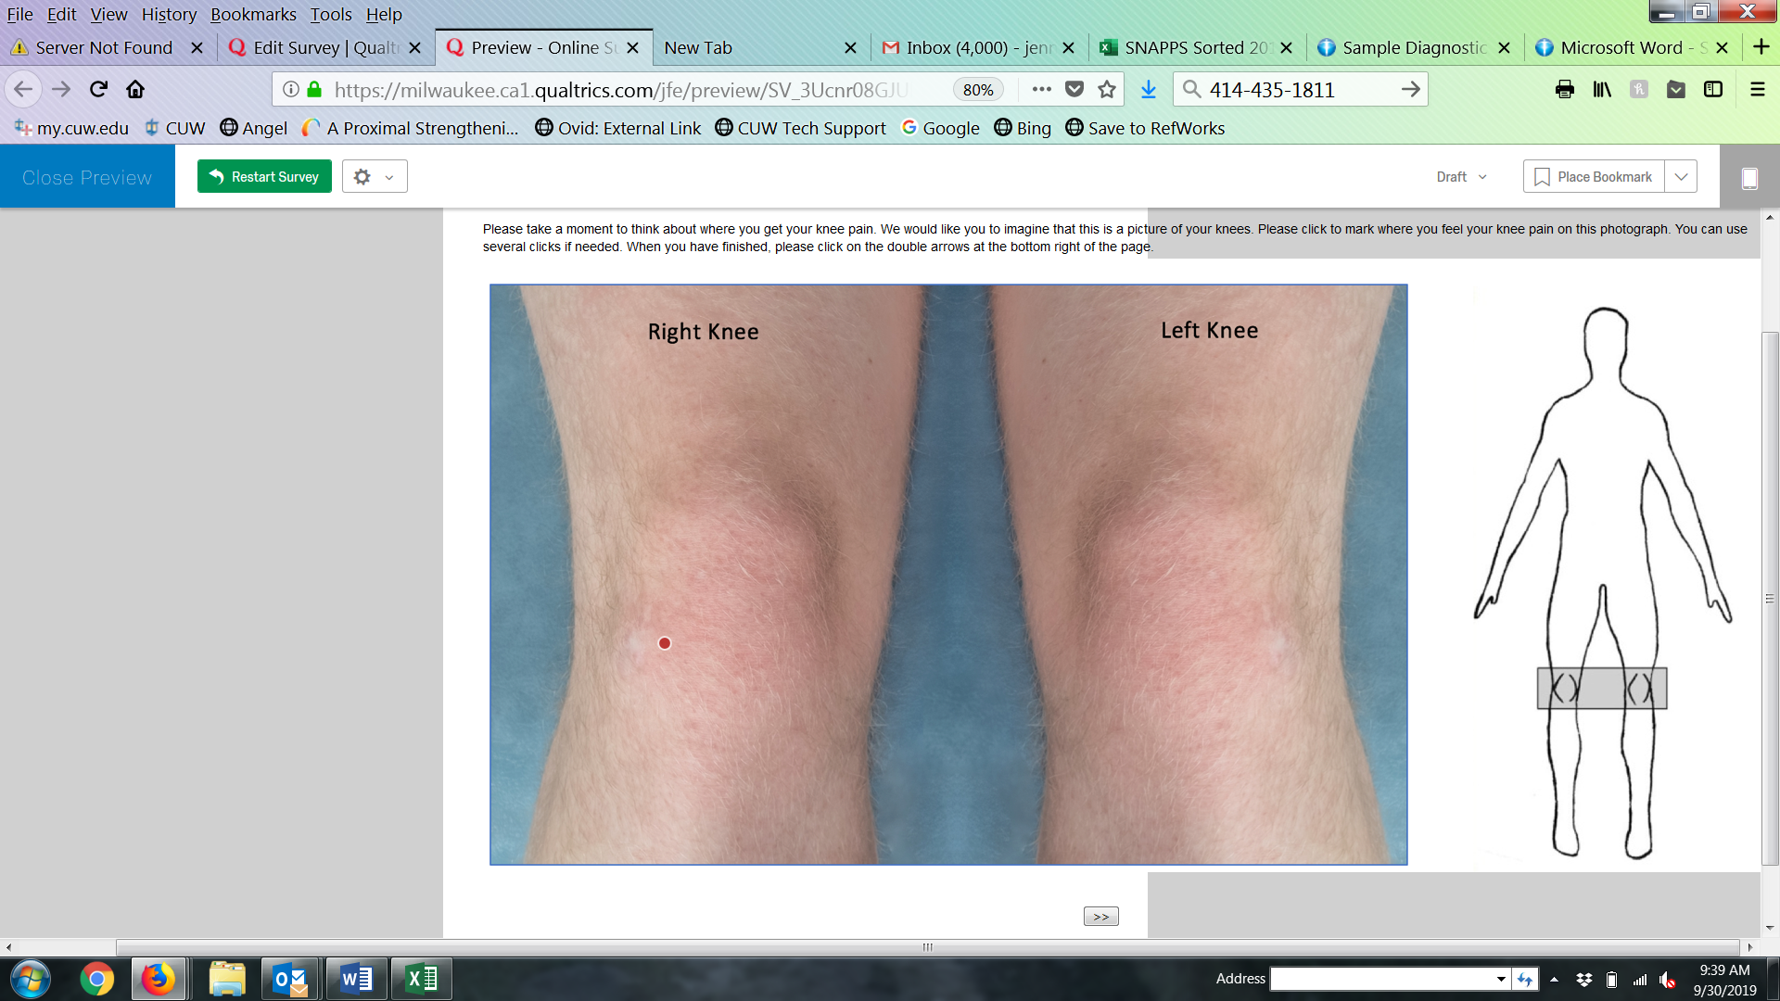
SNAPPS
SNAPPS differentiates PFP from other soft tissue conditions of the knee
over 90% specificity and sensitivity¹
1 point is awarded to each response consistent with PFP
Sections 2 and 4 are added together for a total score. A total score of > 6 = PFP¹
Section 1 asks demographic and screening questions
Section 2 asks clinical questions specific to PFP
Section 3 asks about symptoms during activities
Section 4 consists of a knee pain map to identify location of pain
Adapted the paper version to online version using Qualtrics software
¹ Dey P, Callaghan M, Cook N, et al. A questionnaire to identify patellofemoral pain in the community: an exploration of measurement properties. BMC Musculoskelet Disord. 2016;17:237.

Slide 4

Purpose
To determine the prevalence of PFP in SE Wisconsin using SNAPPS
To identify demographic factors that may be associated with having sought medical attention

Slide 5
Methods
Cross-sectional survey design; shared via social media, email, and in-person
Males & females, 18-40 years old
Overall prevalence rate & stratified by sex
Heat-map plots were created to illustrate frequency of location
Separate chi-square tests of independence (p < 0.05)
Compare prevalence between sexes
Compare having sought medical attention between sexes
Compare duration of symptoms for > 1 month and < 1 month

Slide 6
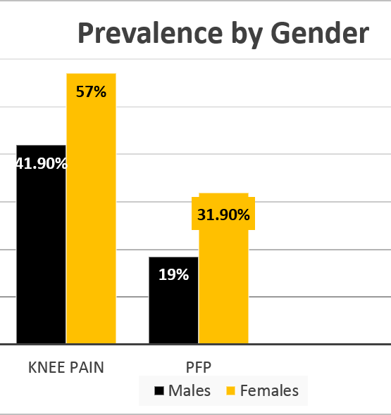
Prevalence Results
Prevalence by Sex
Prevalence Rates
513 respondents, 393 (76%) reported knee pain
139 (27%) scored as likely to have PFP
*
*
*χ2(1)=7.52, p=0.006

Slide 7
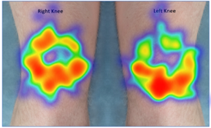
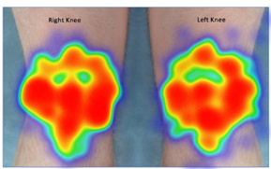
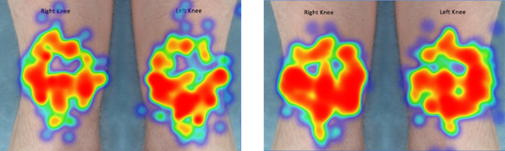
Heat Map Plot Results
Images are representative of the PFP group
No Medical Attention
Medical attention
Symptoms < 1 month
Symptoms > 1 month

Slide 8
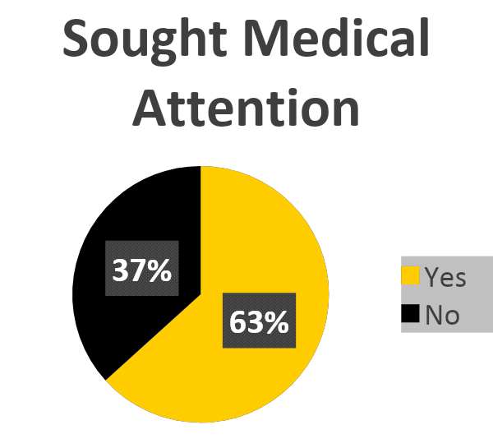
Medical Attention Results
No significant relationship was found between having seen a doctor for pain and sex.
χ²(1)=0.046, p=0.830
Those with symptoms > 1 month were significantly more likely to seek medical attention.
*χ²(1)=7.52, p=0.006

Slide 9
Conclusions
Prevalence of PFP (27%) in this sample is consistent with other research ¹⁻⁴, higher in females than in males
Symptom duration appears to influence whether those with PFP seek medical attention
Future research is needed to further explore this relationship due to influence on treatment outcomes ⁵
¹ Dey P, Callaghan M, Cook N, et al. A questionnaire to identify patellofemoral pain in the community: an exploration of measurement properties. BMC Musculoskelet Disord. 2016;17:237.
² Xu X, Yao C, Wu R, et al. Prevalence of patellofemoral pain and knee pain in the general population of Chinese young adults: a community-based questionnaire survey. BMC Musculoskelet Disord. 2018;19(1):165
³ Boling M, Padua D, Marshall S, Guskiewicz K, Pyne S, Beutler A. Gender differences in the incidence and prevalence of patellofemoral pain syndrome. Scand J Med Sci Sports. 2010;20(5):725–730.
⁴ Smith BE, Selfe J, Thacker D, et al. Incidence and prevalence of patellofemoral pain: A systematic review and meta-analysis. PLoS One. 2018;13(1):e0190892.
⁵ Lankhorst NE, van Middelkoop M, Crossley KM, et al. Factors that predict a poor outcome 5–8 years after the diagnosis of patellofemoral pain: a multicentre observational analysis. British Journal of Sports Medicine 2016;50:881-886.

Slide 10
References
¹ Dey P, Callaghan M, Cook N, et al. A questionnaire to identify patellofemoral pain in the community: an exploration of measurement properties. BMC Musculoskelet Disord. 2016;17:237.
² Xu X, Yao C, Wu R, et al. Prevalence of patellofemoral pain and knee pain in the general population of Chinese young adults: a community-based questionnaire survey. BMC Musculoskelet Disord. 2018;19(1):165
³ Boling M, Padua D, Marshall S, Guskiewicz K, Pyne S, Beutler A. Gender differences in the incidence and prevalence of patellofemoral pain syndrome. Scand J Med Sci Sports. 2010;20(5):725–730.
⁴ Smith BE, Selfe J, Thacker D, et al. Incidence and prevalence of patellofemoral pain: A systematic review and meta-analysis. PLoS One. 2018;13(1):e0190892.
⁵ Lankhorst NE, van Middelkoop M, Crossley KM, et al. Factors that predict a poor outcome 5–8 years after the diagnosis of patellofemoral pain: a multicentre observational analysis. British Journal of Sports Medicine 2016;50:881-886.

